Slide 1

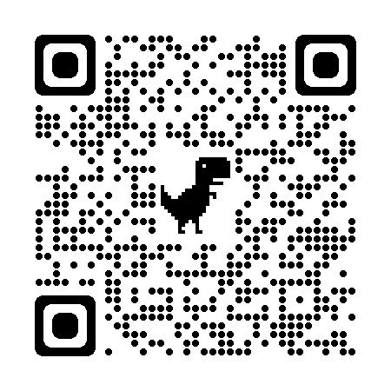

QR CODE BASED CITIZEN FEEDBACK SYSTEM FOR GUJARAT POLICE.
PREPARED BY :-
VAIDEHI GHODASARA
21CS011
GUIDED BY :- PROF. VAIBHAVI PATEL

Slide 2
CONTENT :-
INTRODUCTION
PROBLEM STATEMENT
NEED FOR THE SYSTEM
FLOW DIAGRAM
DESIGN AND DEVELOPMENT PROCESS
SCREENSHOT OF RESULT

Slide 3
PROBLEM STATEMENT :-
QR CODE BASED CITIZEN FEEDBACK SYSTEM FOR GUJARAT POLICE

Slide 4
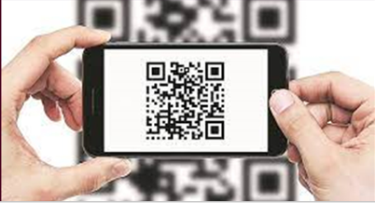
PROJECT OVERVIEW :-
QR CODE BASED FEEDBACK SYSTEM FOR GUJARAT POLICE IS DEVELOPED KEEPING FOLL. IN MIND :-
FORMS ALLOWS AN INDIVIDUAL TO COMPREHEND THEIR COMPLICATIONS BY JUST SCANNING QUICK RESPONSE CODE IN ANY OF DEGITAL DEVICE
ONE CAN REGISTER COMPLAINT EASILY WITHOUT ANY LOCATION/TIME CONSTRAINTS
FEEDBACK DETAILS ARE BEEN UNABLED TO BE MODIFIED BY POLICE OFFICER IN POLICE STATION
ADMIN CAN ANALAYSE DATA IN PIE-CHART FORMAT
ADMIN CAN HAVE A PROPER LOOKOUT ON POLICE STATION FROM ANYWHERE OF ANY POLICE STATION

Slide 5
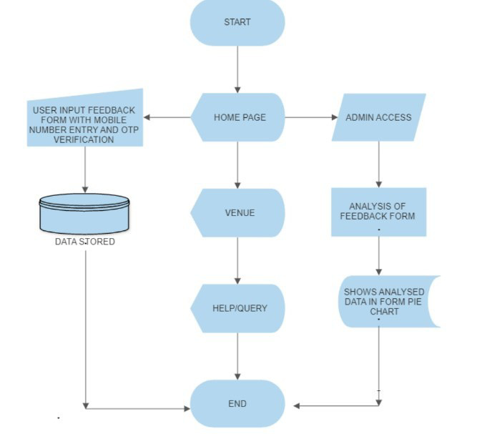
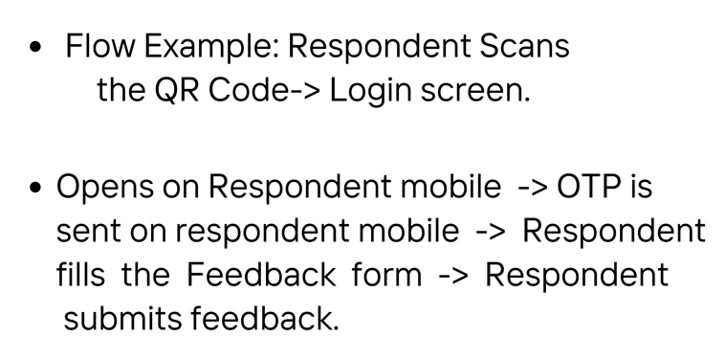
FLOW DIAGRAM

Slide 6
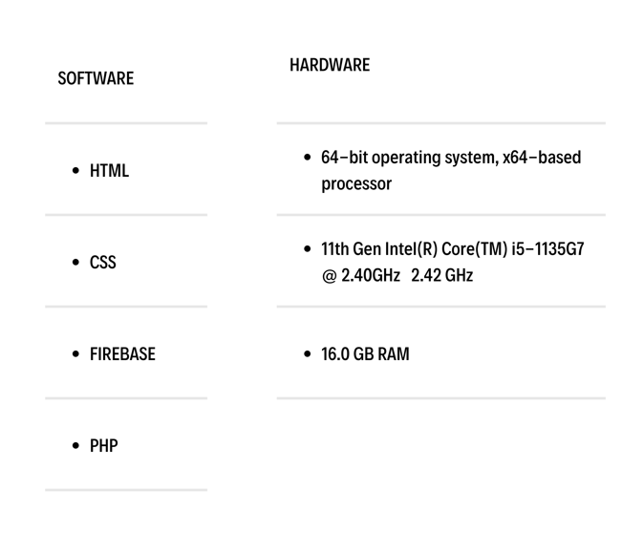
PRE-REQUISITS :-

Slide 7
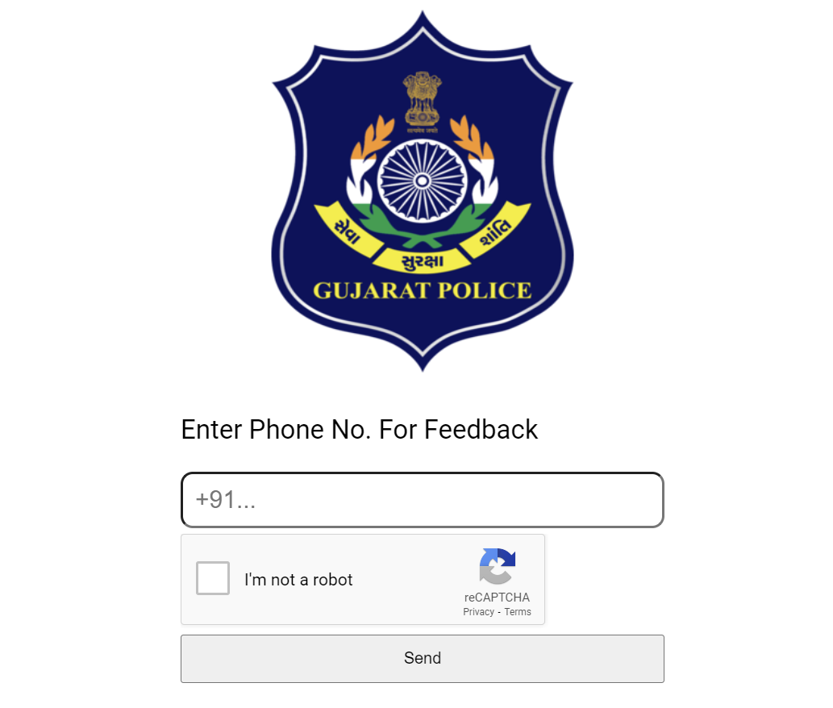
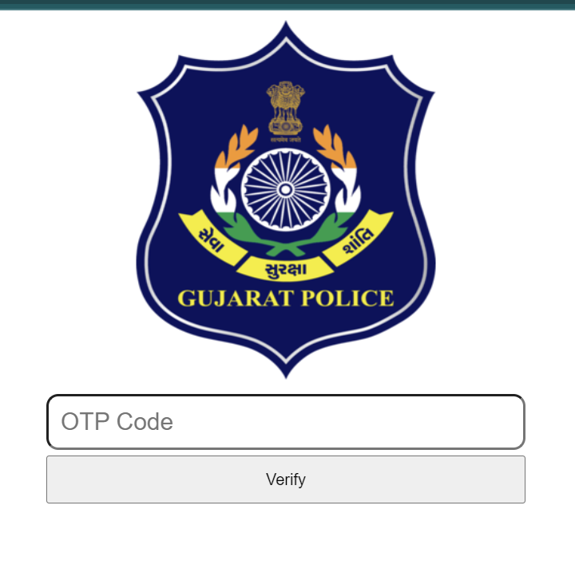
DESIGN AND DEVELOPMENT PROCESS
QR CODE
ENTER OTP
ENTER MOBILE NUMBER

Slide 8
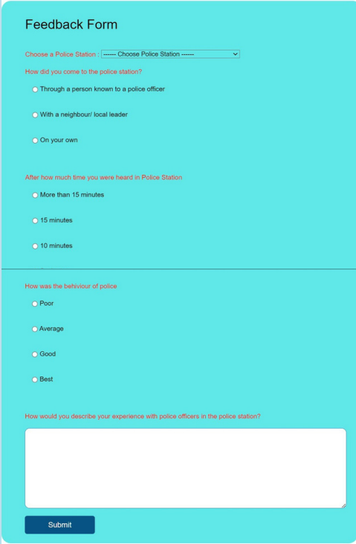
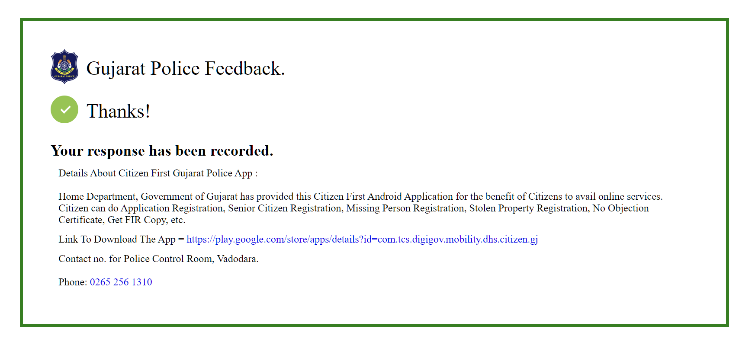
FEEDBACK FORM

Slide 9
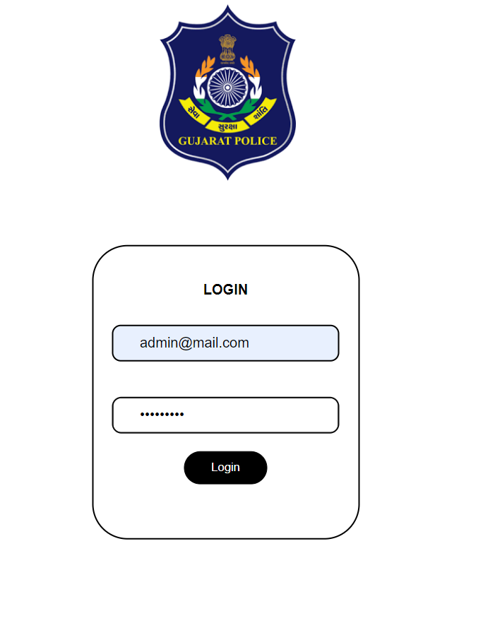
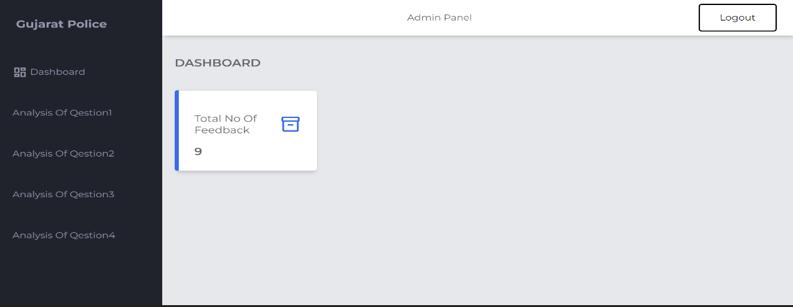
ADMIN MODULE

Slide 10
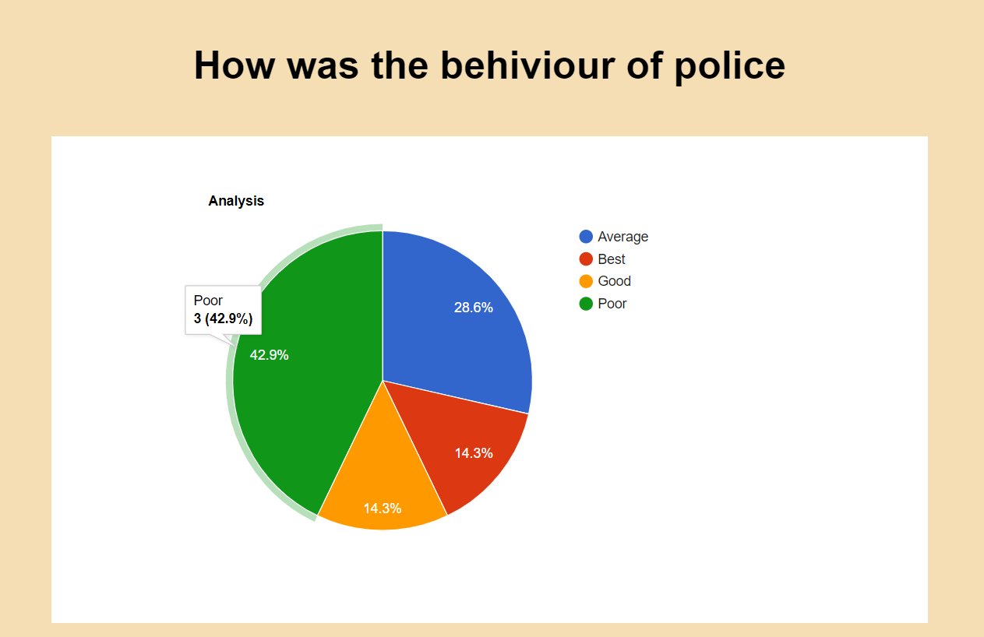
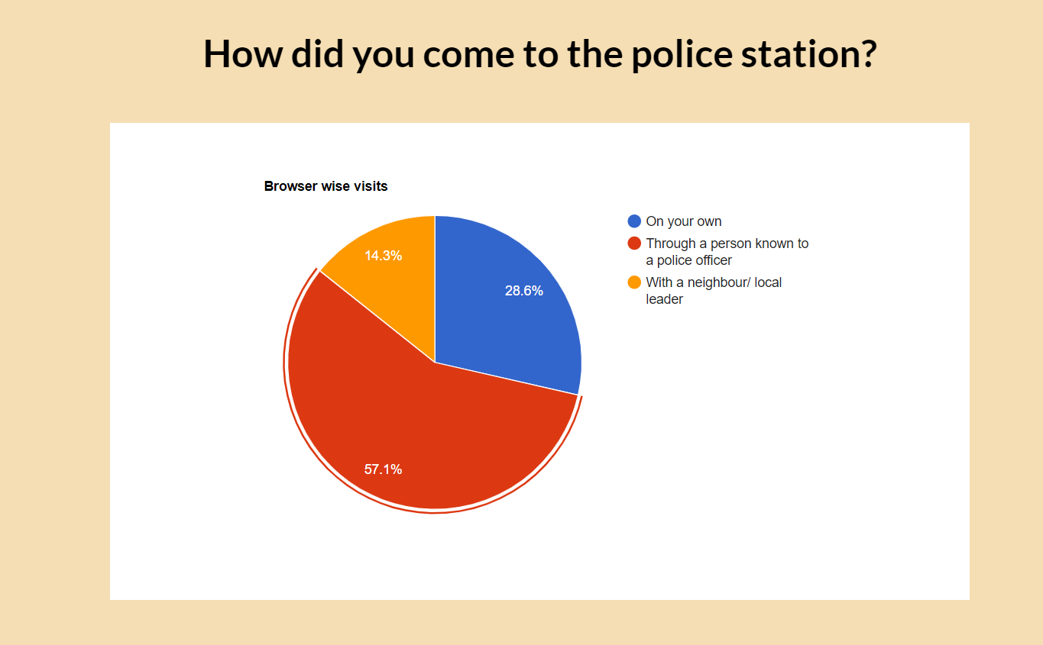
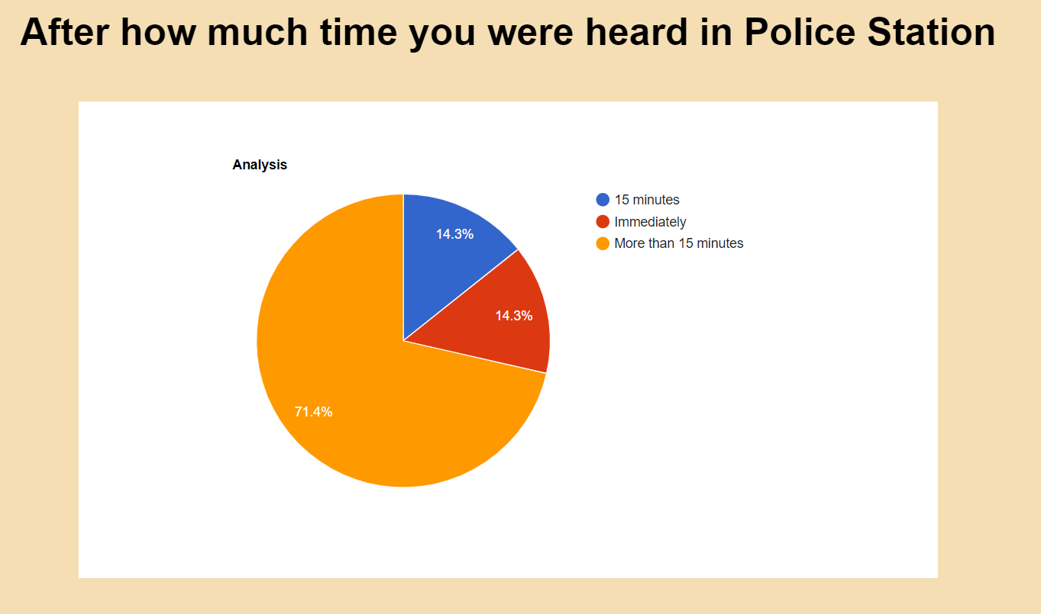
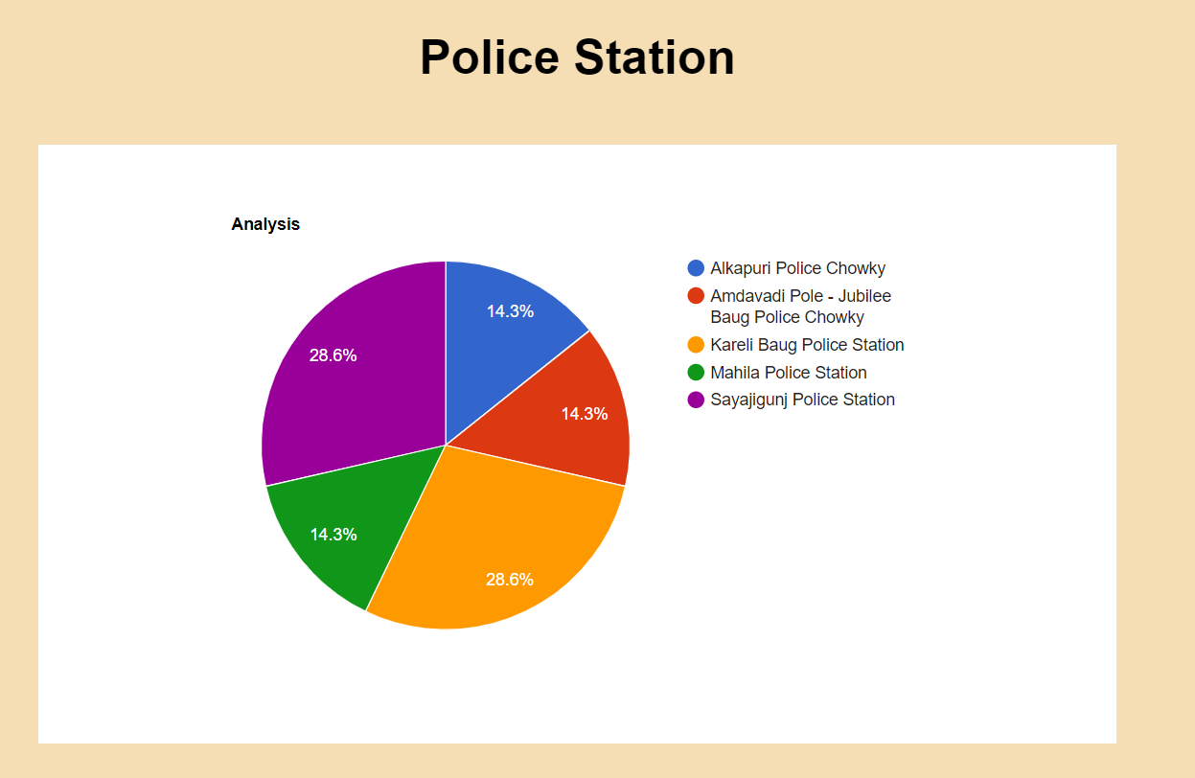
SCREENSHOT OF RESULT

Slide 11
THANK YOU

